Slide 1

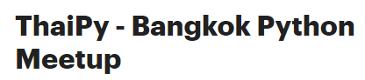
Responsible AI toolkits
SeokJin Han
Microsoft
linkedin.com/in/seokjinhan
sehan@microsoft.com

Slide 2
Progression of Responsible AI
Principles
Practices
Tools
Fairness
AETHER committee
Homomorphic Encryption
Reliability & Safety
The Partnership on AI
Interpret ML
Inclusiveness
Differential Privacy
Privacy & Security
Guidelines for
Human-AI Design
Data Drift
Transparency
Guidelines for
Conversational AI
Accountability
Secure MPC

Slide 3
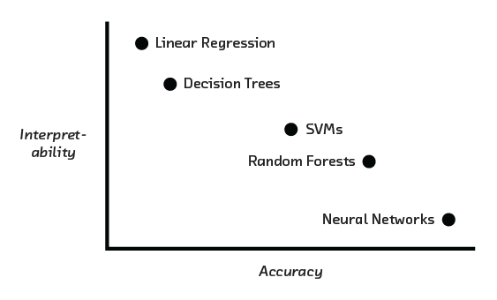
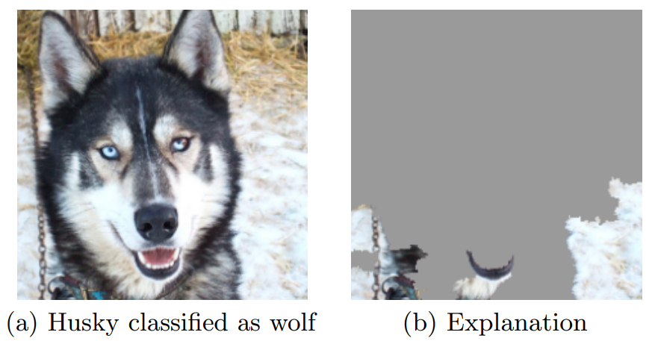
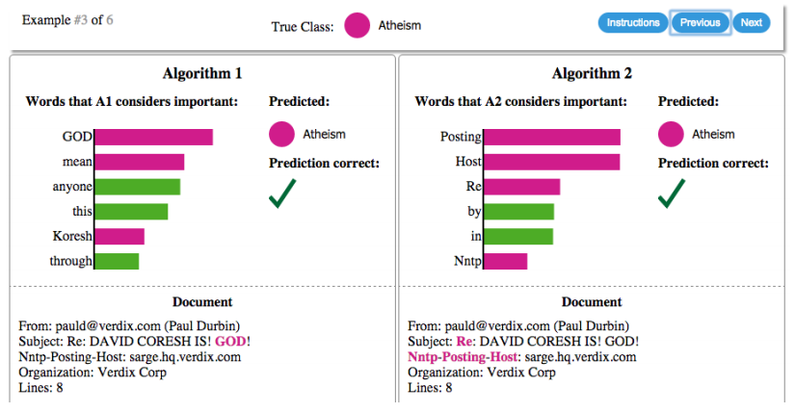
Why this matters?
“If you can't explain it simply, you don't understand it well enough.“ — Albert Einstein
Accuracy (as a whole) is not enough
Is my model predicting well, or am I totally mistaken?
Dare to explain?
Source: https://arxiv.org/abs/1602.04938, “Why Should I Trust You?”: Explaining the Predictions of Any Classifier

Slide 4
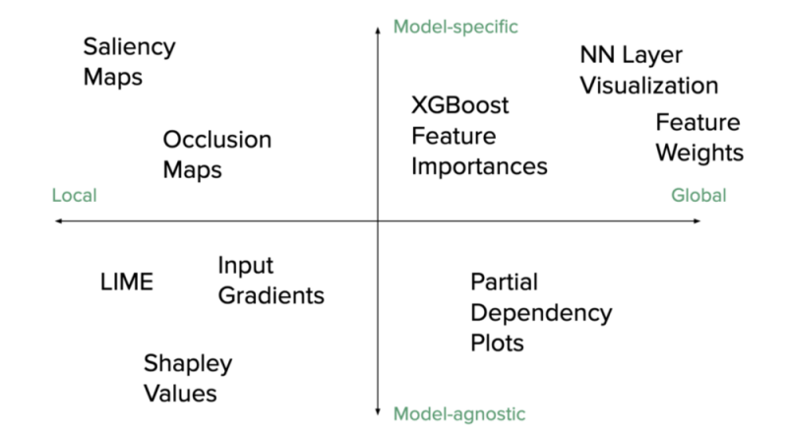
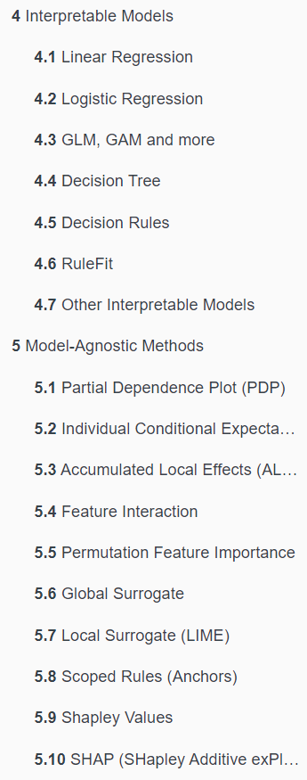
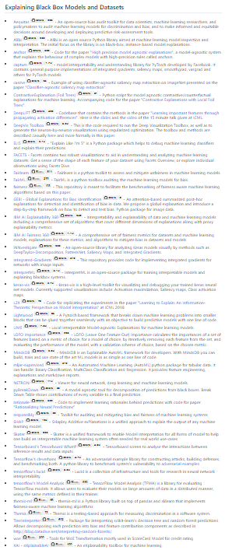


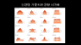
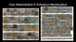
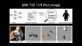
Efforts to explain models
X-axis | Local | Explain locally (individual filters in NN etc)
 | Global | Explain globally (visualize weights and biases in NN etc)
Y-axis | Model-agnostic | Can apply to many model types
 | Model-specific | Works for specific model types
Source: https://github.com/Harvard-IACS/2020-ComputeFest/, https://christophm.github.io/interpretable-ml-book/,
https://github.com/EthicalML/awesome-production-machine-learning#explaining-black-box-models-and-datasets

Slide 5
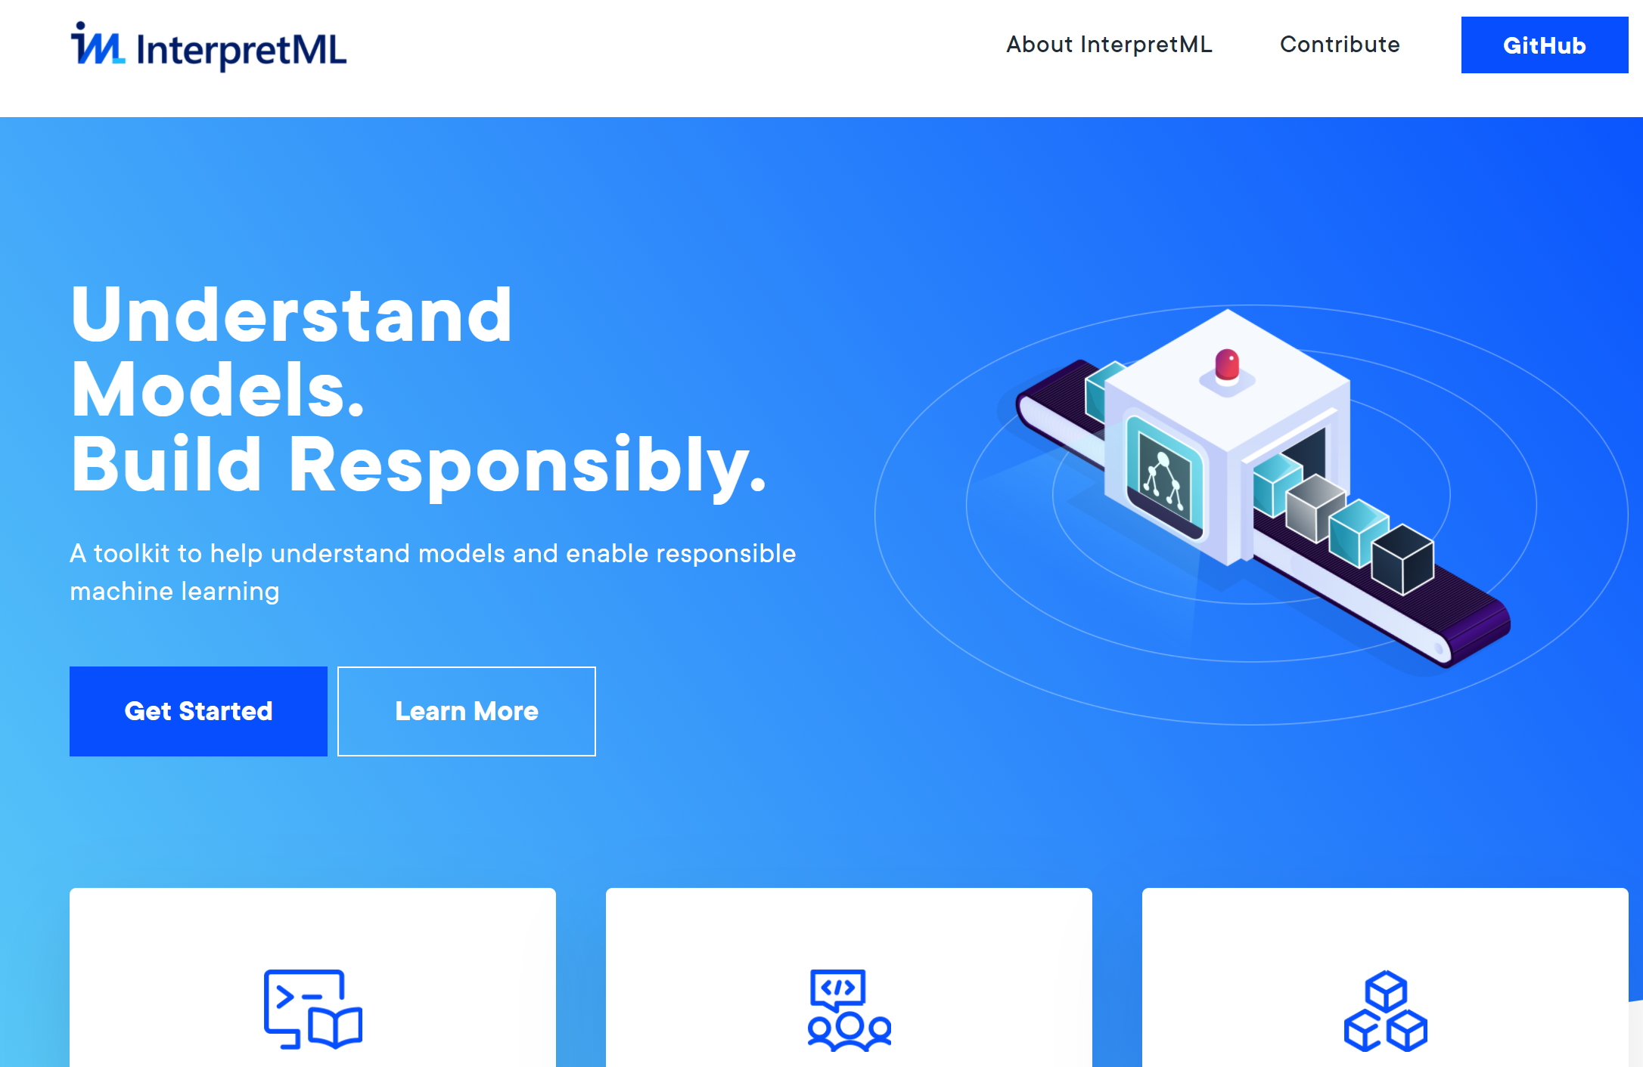
InterpretML

Slide 6
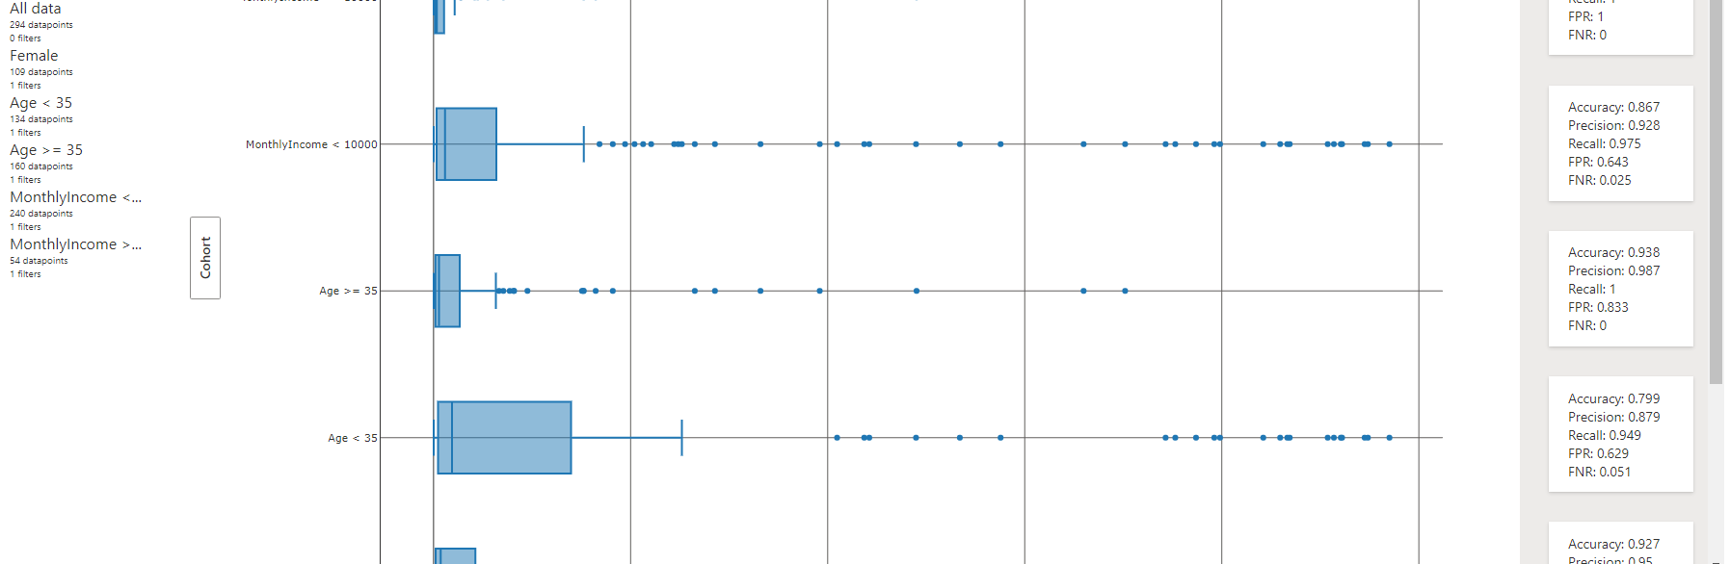

Does Model perform differently per Cohort?

Slide 7
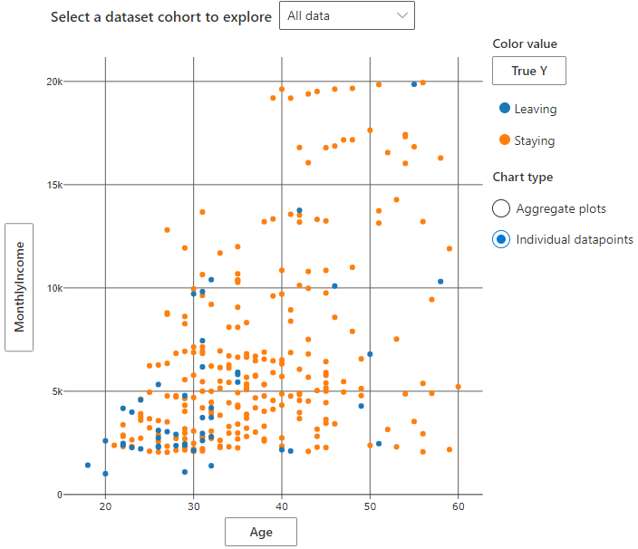
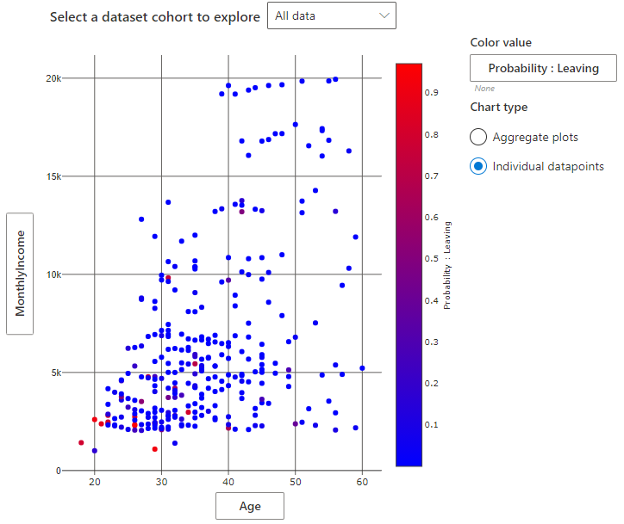
Are they making more money (on average) as they grow older? When are they actually leaving? When are they predicted to leave? Does it change due to Gender?

Slide 8
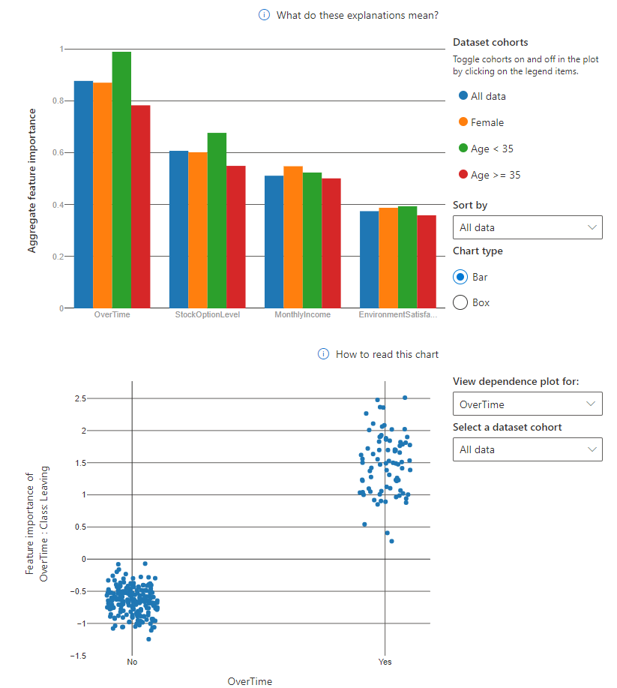
What are the most important features? How much does Over Time affect attrition? What about Stock Option Level, Monthly Income? Does Gender, Age make a difference?

Slide 9
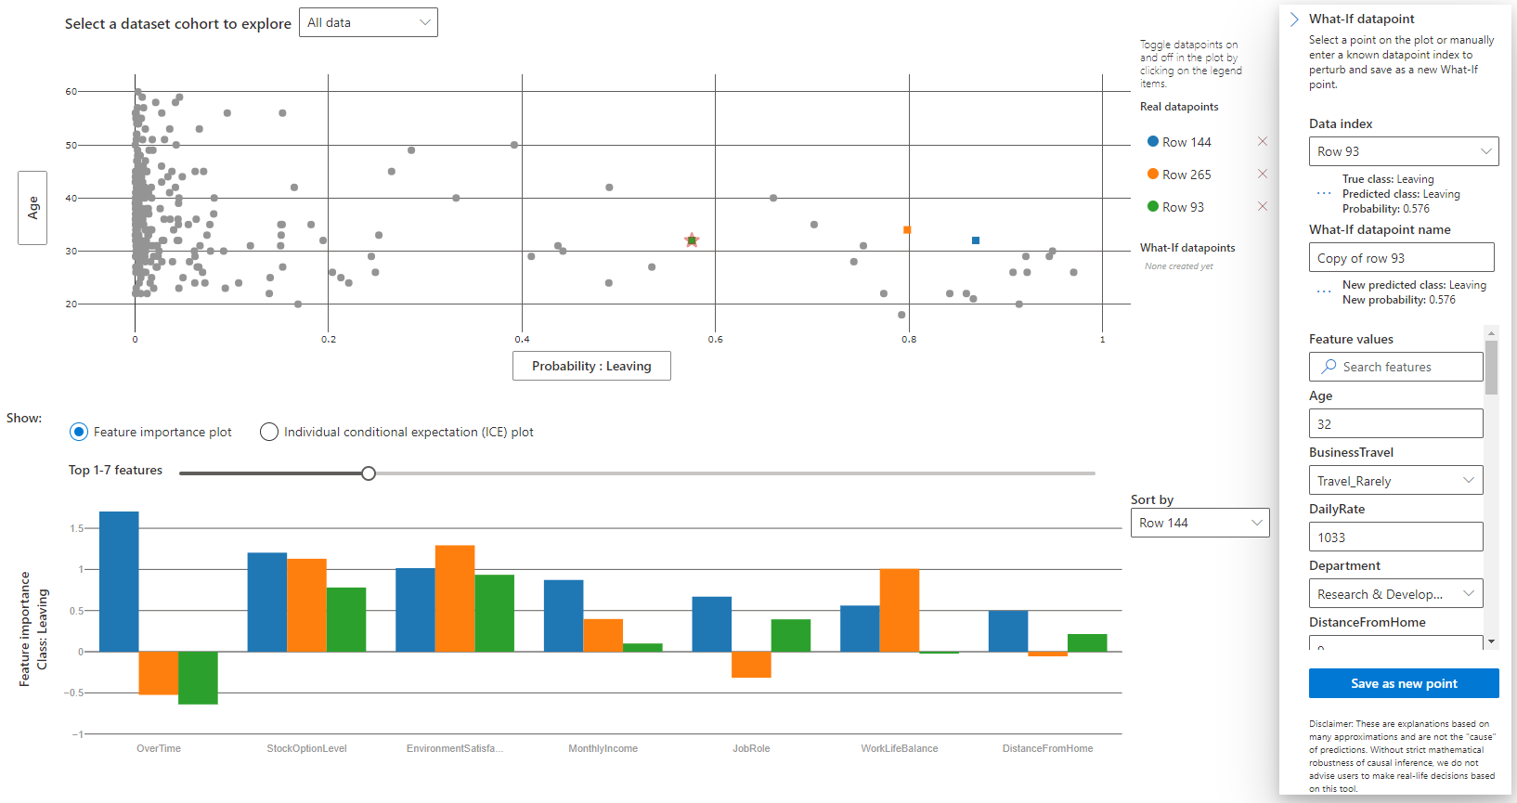
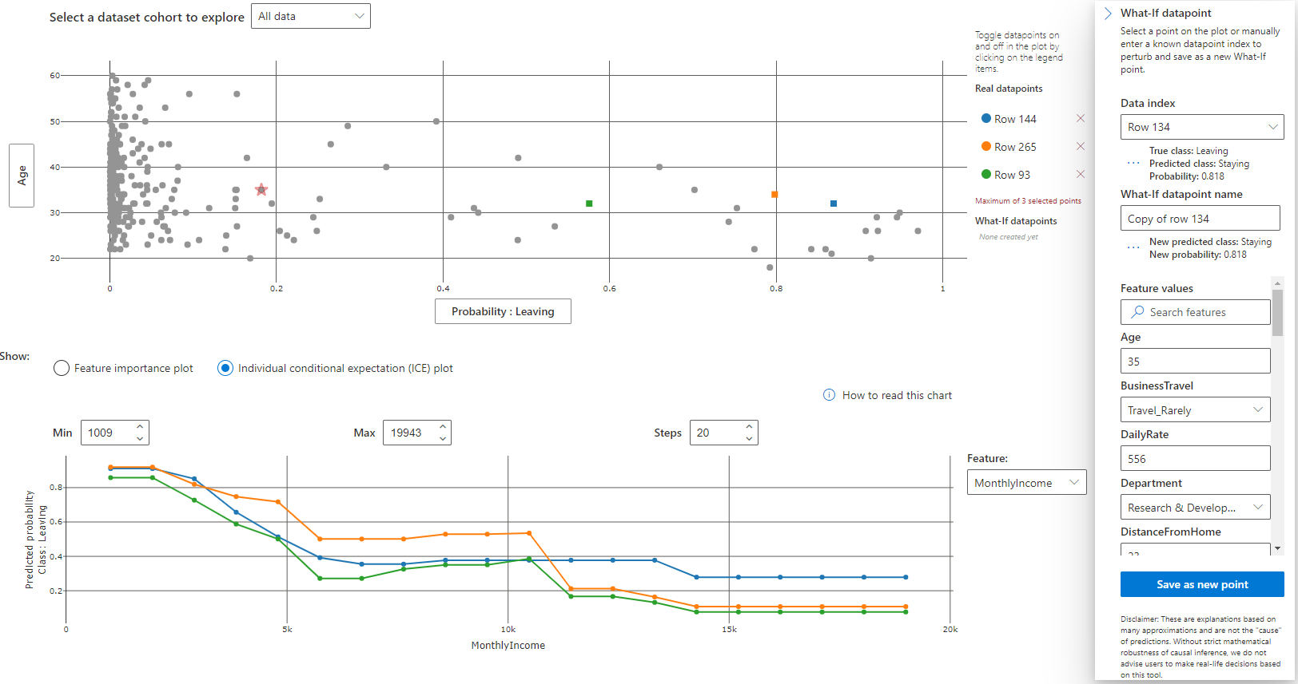
Take 3 employees with similar age, can we tell what is the most importance feature for each person according to the model? What is the impact of Age, Environment Satisfaction, Monthly Income on the probability of Leaving, and how does the impact differ per person?

Slide 10
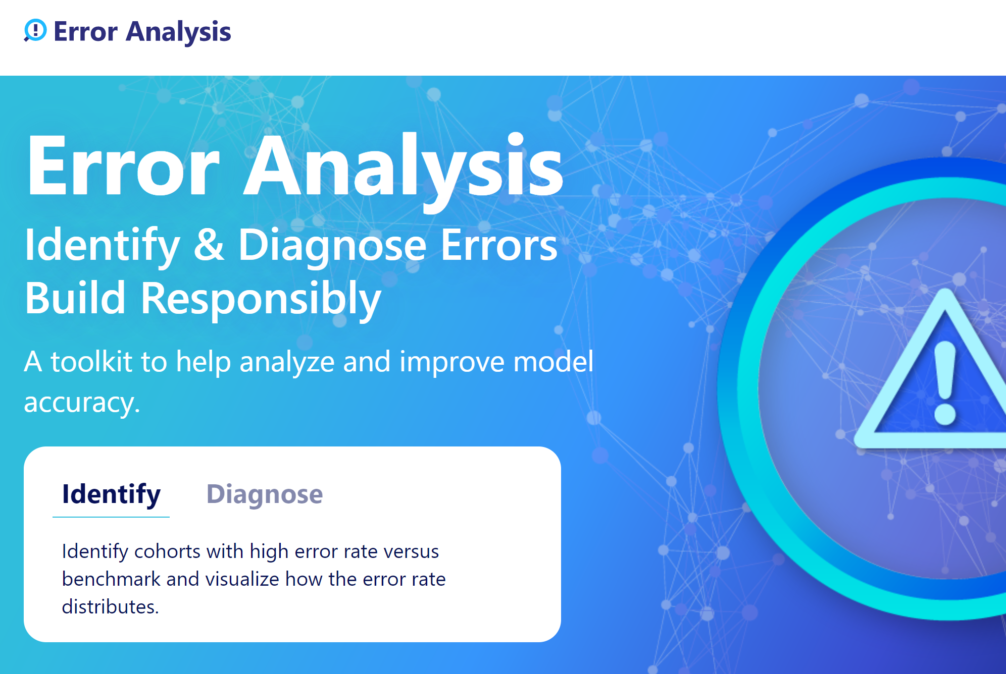
Error Analysis

Slide 11
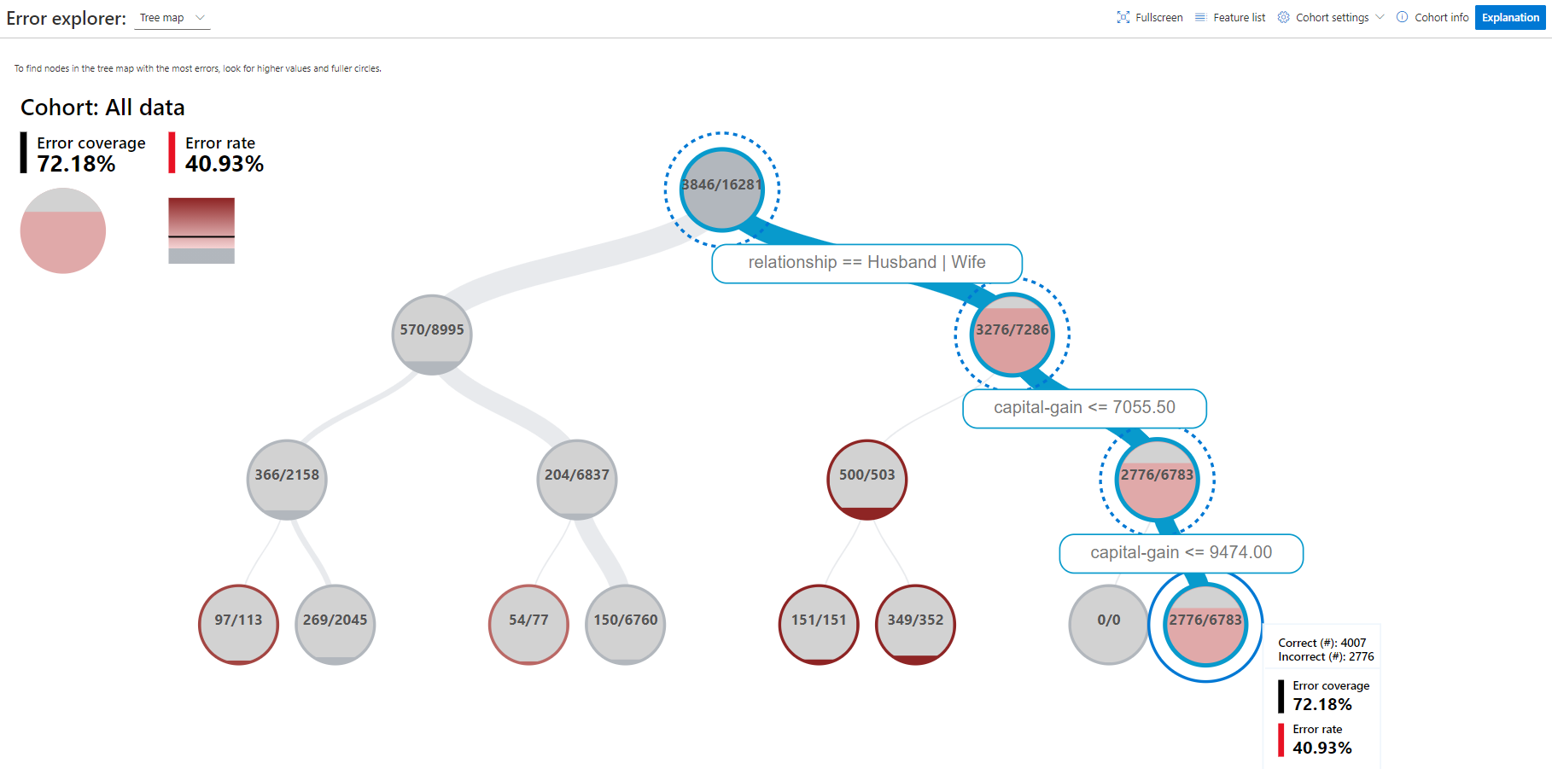
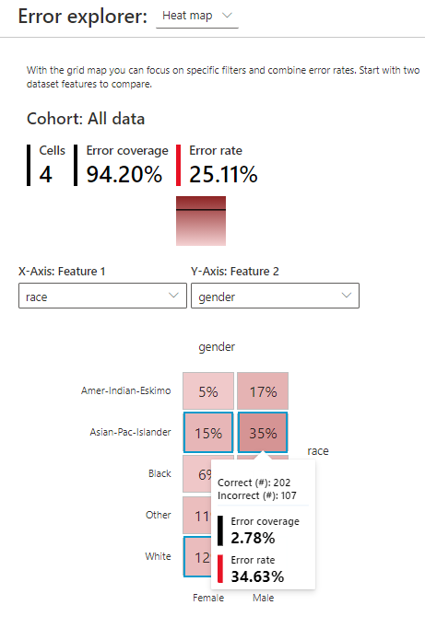
Which segments cover the most errors? Which segments have the highest error rates?

Slide 12
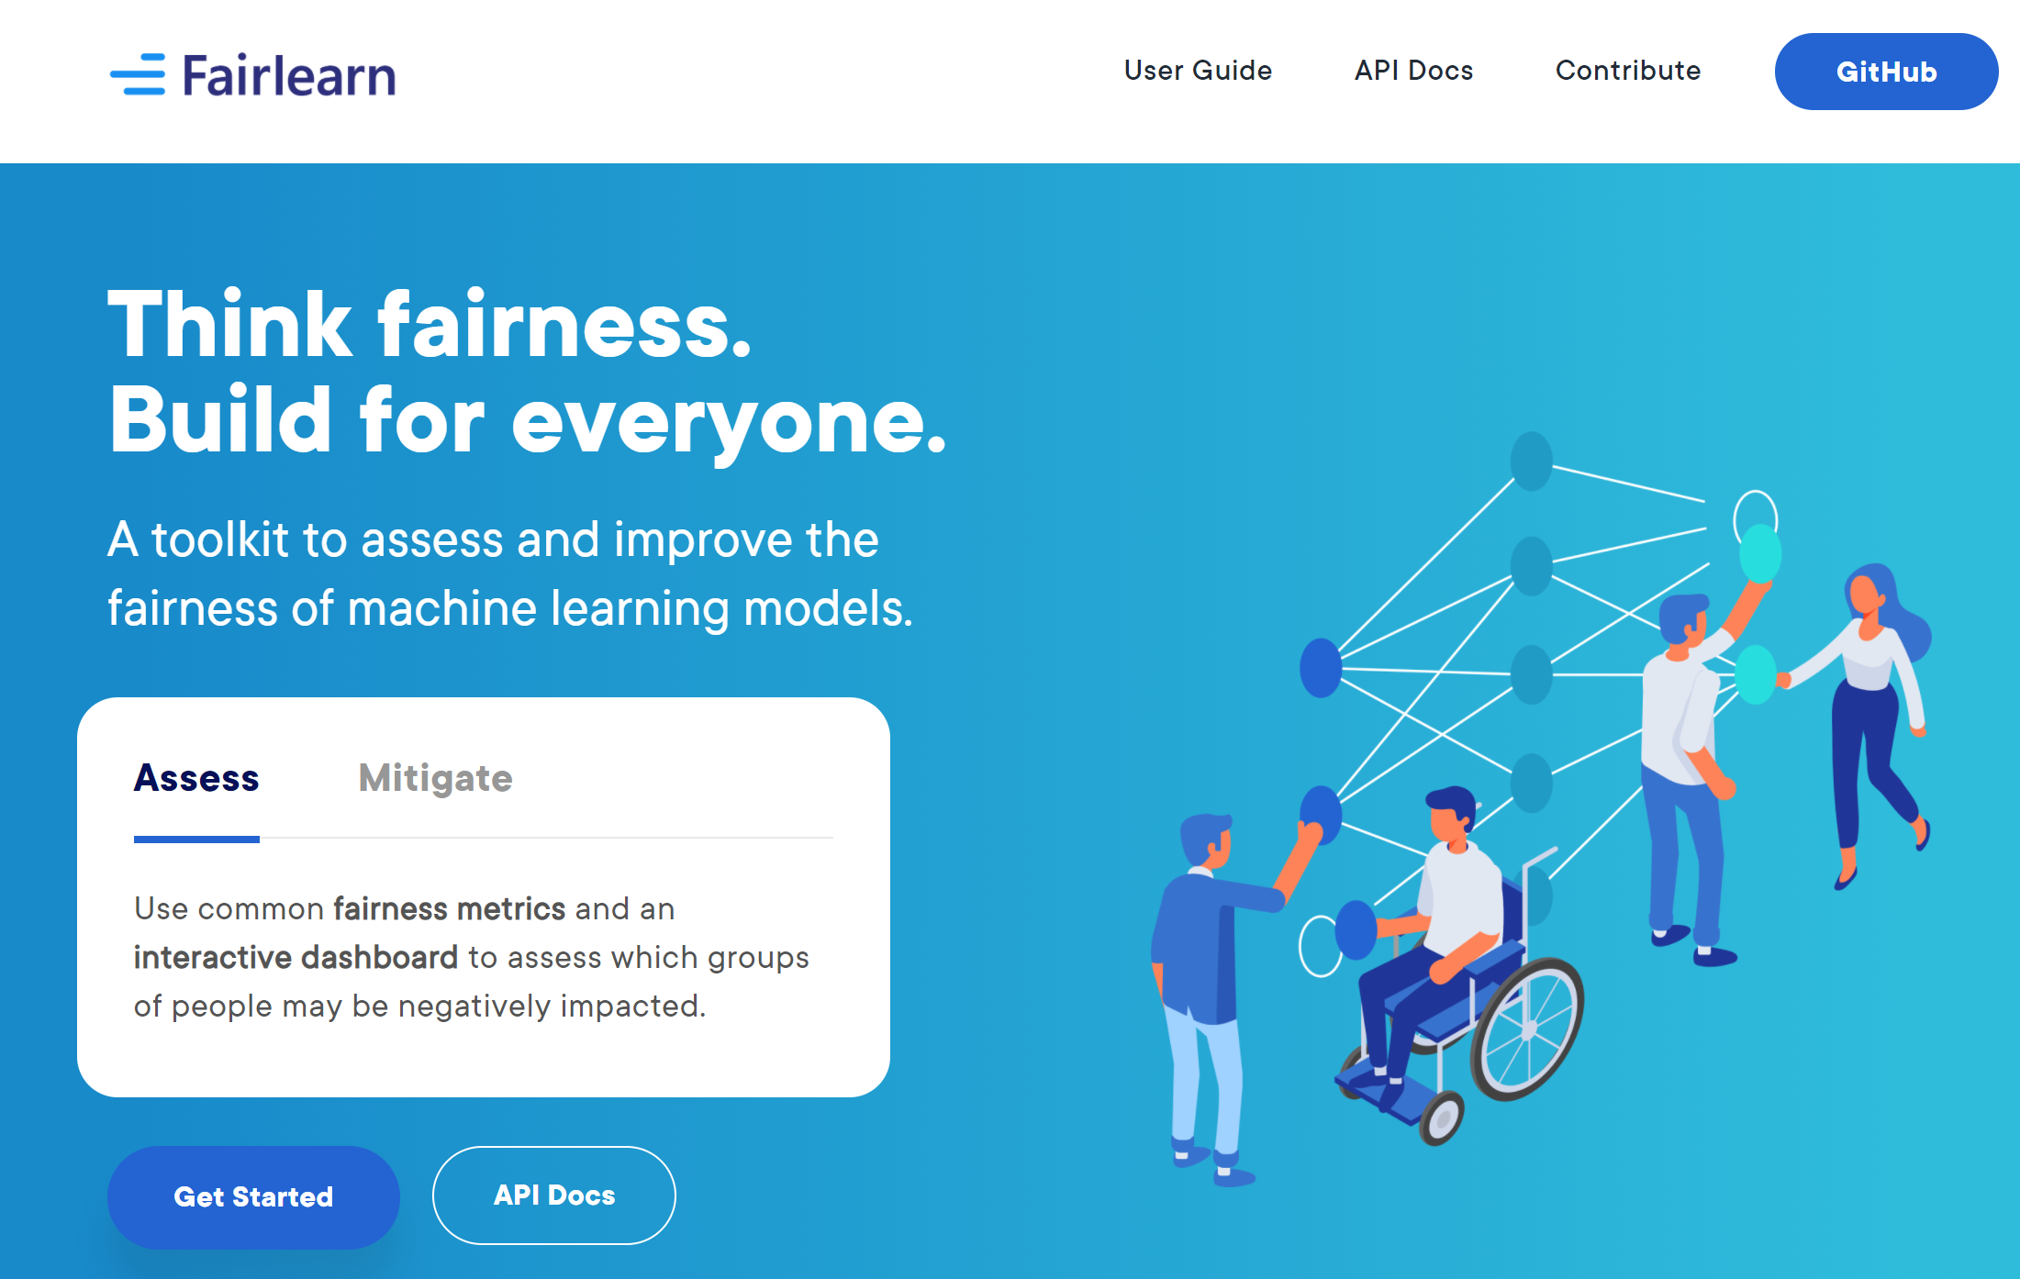
Fairlearn

Slide 13
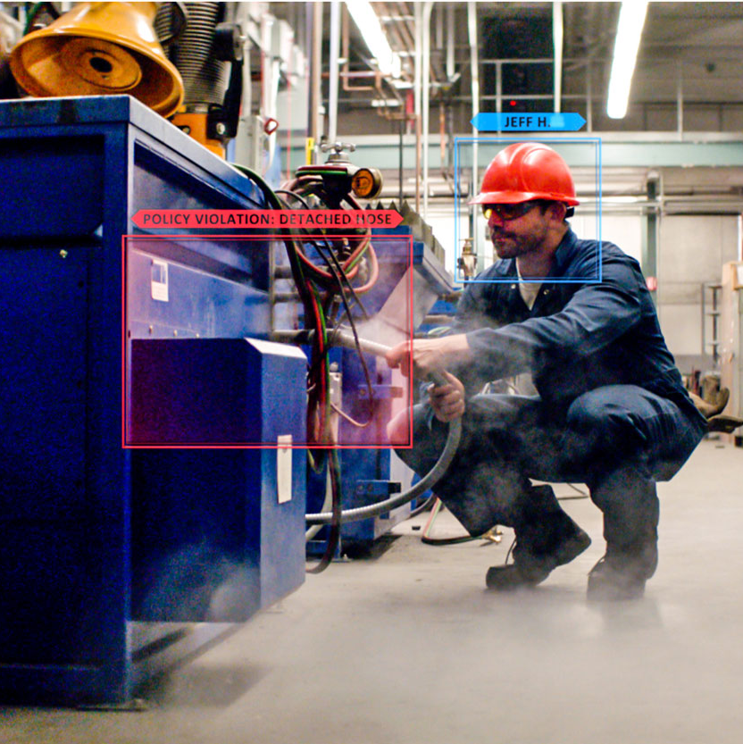
Understand
Interpretability
Fairness
Control
Audit trail
Datasheets
Azure Machine Learning
Protect
Differential privacy
Confidential machine learning
Responsible ML

Slide 14
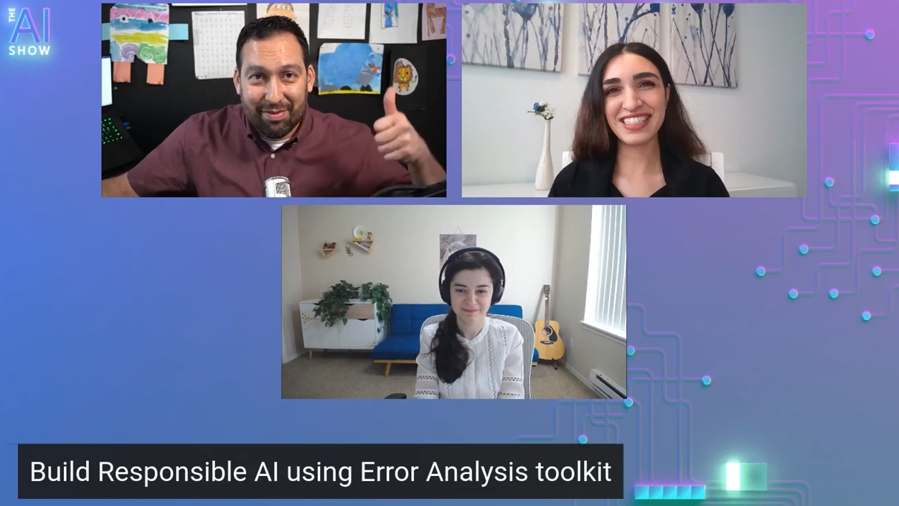
Codes, Blogs, Videos
https://github.com/dem108/explain-ml-models
Enabling responsible AI development with new open-source capabilities
https://github.com/microsoft/responsible-ai-widgets
InterpretML
Error Analysis
Build Responsible AI using Error Analysis toolkit – YouTube
Responsible Machine Learning with Error Analysis – Microsoft Blog
Model interpretability in Azure Machine Learning
Responsible AI at Microsoft

Slide 15
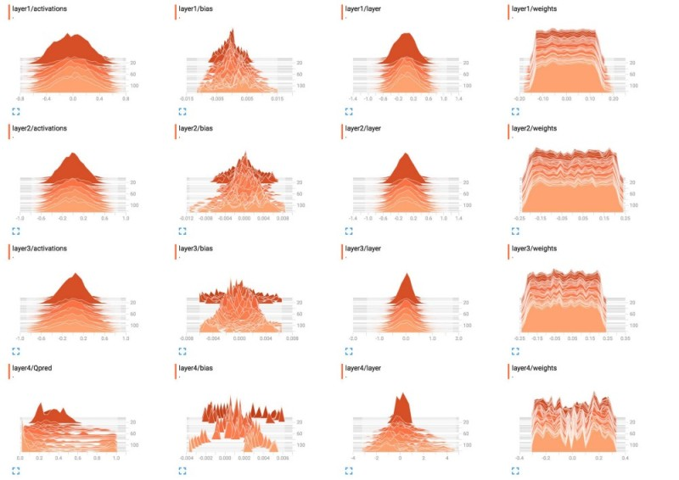
Visualizing weights and biases in neural networks

Slide 16
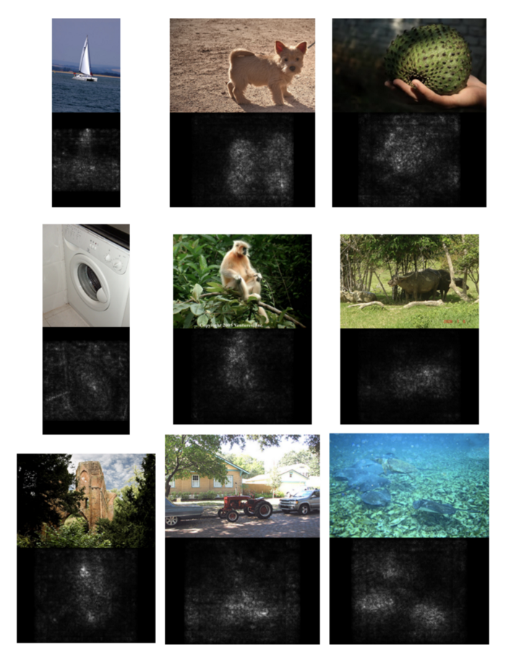
Salient Map

Slide 17
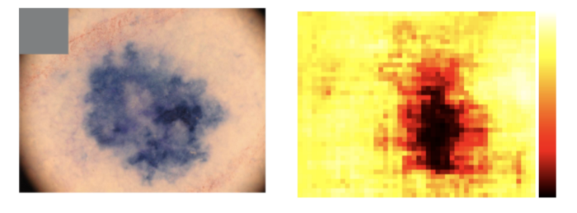
Occlusion Map

Slide 18
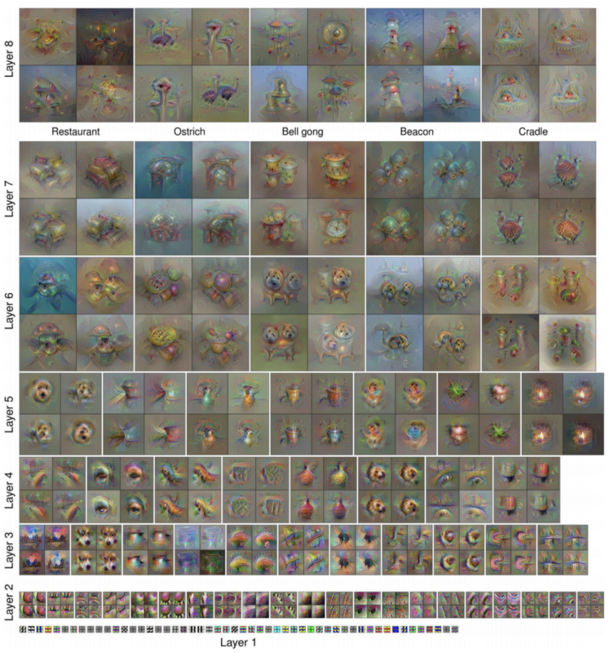
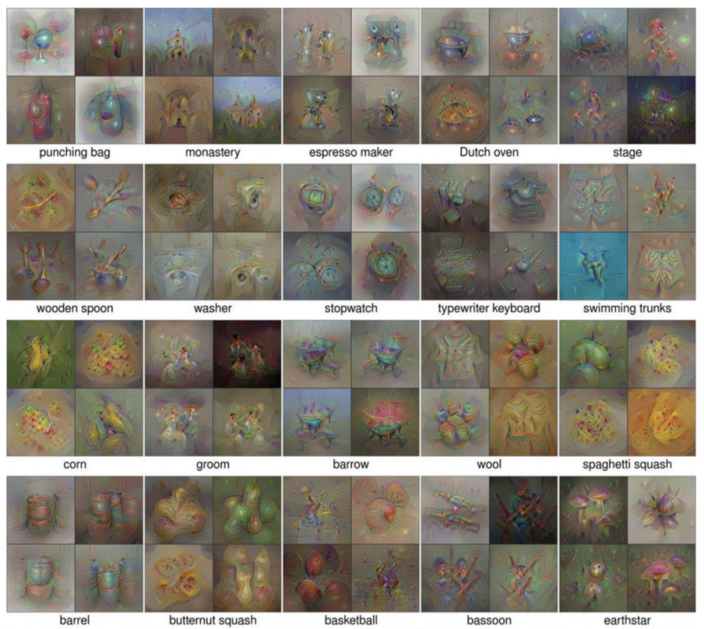
Class Maximization and Activation Maximization

Slide 19
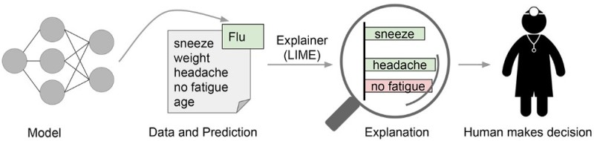
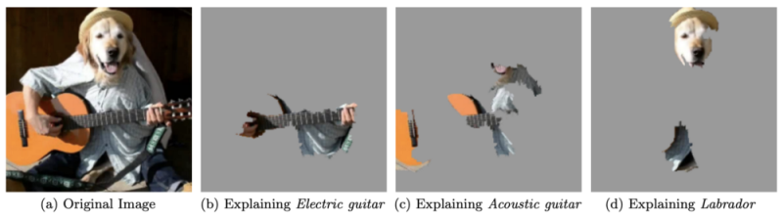
Application of LIME (Text, Image)

